Slide 1
Lecture 7
Android
Services, Broadcast Receivers, Content Providers

Slide 2
Services
A service is a component that runs in the background to perform long-running operations without needing to interact with the user and it works even if application is destroyed. A service can essentially take two states −
State | Description
Started | A service is started when an activity, starts it by calling startService(). Once started, a service can run in the background indefinitely.
Bound | A service is bound when an ctivity binds to it by calling bindService(). A bound service offers a client-server interface that allows to interact with the service, send requests, get results.

Slide 3
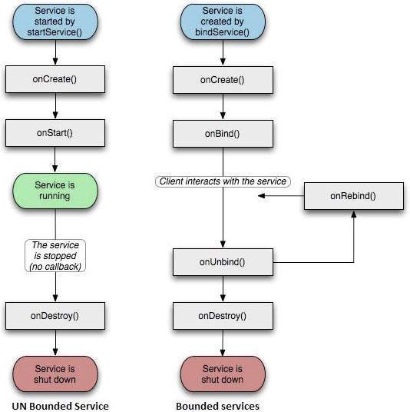
Services

Slide 4
Services
Callback Method | Description
onCreate() | The system calls this method when the service is first created using onStart() or onBind().
onStart() | The system calls this method when an activity, requests that the service be started, by calling startService(). If you implement this method, it is your responsibility to stop the service when its work is done, by calling stopService() methods.
onBind() | The system calls this method when another component wants to bind with the service by calling bindService().
onUnbind() | The system calls this method when all clients have disconnected from a particular interface published by the service.
onRebind() | The system calls this method when new clients have connected to the service, after it had previously been notified that all had disconnected in its onUnbind.
onDestroy() | The system calls this method when the service is no longer used and is being destroyed.

Slide 5
Broadcast Receivers
Broadcast Receivers simply respond to broadcast messages from other applications or from the system itself. These messages are sometime called intents.
There are following two important steps to make BroadcastReceiver :-
Creating the Broadcast Receiver.
Registering Broadcast Receiver.

Slide 6
Broadcast Receivers
1. Creating the Broadcast Receiver……..
A broadcast receiver is implemented as a subclass of BroadcastReceiver class and overriding the onReceive() method where each message is received as a Intent object parameter.
Syntax:
public class MainActivity extends BroadcastReceiver
{
public void onReceive(Context context, Intent intent)
{
Toast.makeText(getApplicationContext(), "Intent Detected", Toast.LENGTH_LONG).show();
}
}

Slide 7
Broadcast Receivers
2. Registering Broadcast Receiver……
An application listens for specific broadcast intents by registering a broadcast receiver in AndroidManifest.xml file. Consider we are going to register MainActivity for system generated event ACTION_BOOT_COMPLETED which is fired by the system once the Android system has completed the boot process.
Syntax:
<application
android:icon="@drawable/ic_launcher"
android:label="@string/app_name"
android:theme="@style/AppTheme“>
<receiver android:name="MainActivity">
<intent-filter>
<action android:name="android.intent.action.BOOT_COMPLETED"> </action>
</intent-filter>
</receiver>
</application>

Slide 8
Broadcast Receivers
Intent/Event
android.intent.action.BATTERY_CHANGED
android.intent.action.BATTERY_LOW
android.intent.action.BATTERY_OKAY
android.intent.action.BOOT_COMPLETED
android.intent.action.BUG_REPORT
android.intent.action.CALL
android.intent.action.DATE_CHANGED
android.intent.action.TIME_CHANGED
android.intent.action.REBOOT

Slide 9
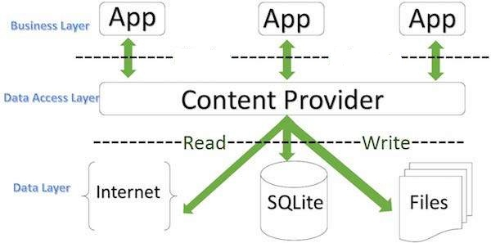
Content Providers
A content provider component supplies data from one application to others on request. Such requests are handled by the methods of the ContentResolver class. A content provider can use different ways to store its data and the data can be stored in a database, in files, or even over a network.

Slide 10
Content Providers
A content provider is implemented as a subclass of ContentProvider class.
Syntax:-
public class MainActivity extends ContentProvider { }

Slide 11
Content Providers
Steps to create Content Provider:
1. First of all you need to create a Content Provider class.
2. Second, you need to define your content provider URI address which will be used to access the content.
3. Next you will need to create your own database to keep the content.
4. Next you will have to implement Content Provider queries to perform different database specific operations.
5. Finally register your Content Provider in your activity file using <provider> tag.

Slide 12
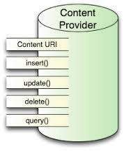
Content Providers
Here is the list of methods which you need to override in Content Provider class:

Slide 13
Content Providers
onCreate() : This method is called when the provider is started.
query(): This method receives a request from a client.
insert(): This method inserts a new record into the content provider.
delete(): This method deletes an existing record from the content provider.
update(): This method updates an existing record from the content provider.
getType(): This method returns the type of the data at the given URI(Uniform Resource Identifier).

